Slide 1
Integrated Assessment Models for Air Pollution: Methods, Challenges, Applications
N.Z. Muller
AERE Conference Workshop
Spring, 2019

Slide 2
Motivation for LAP IAMs
Many important economic and policy questions span multiple scientific disciplines.
How to generate electric power?
How to produce transportation services?
Measuring output and growth.
Necessitates models that combine, or integrate, findings from multiple disciplines.
We’ve seen the motivation for climate IAMs.
Now let’s consider local air pollution.

Slide 3
Market and Policy
Forces
Emissions
Valuation
Air Quality
Model
Integrated
Assessment
Models
Dose-Response
Ambient
Concentration
Exposure

Slide 4

Market and Policy
Forces

Slide 5
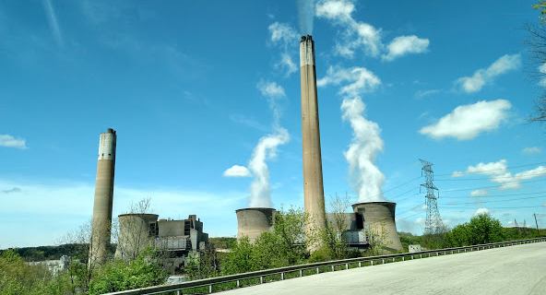

Slide 6
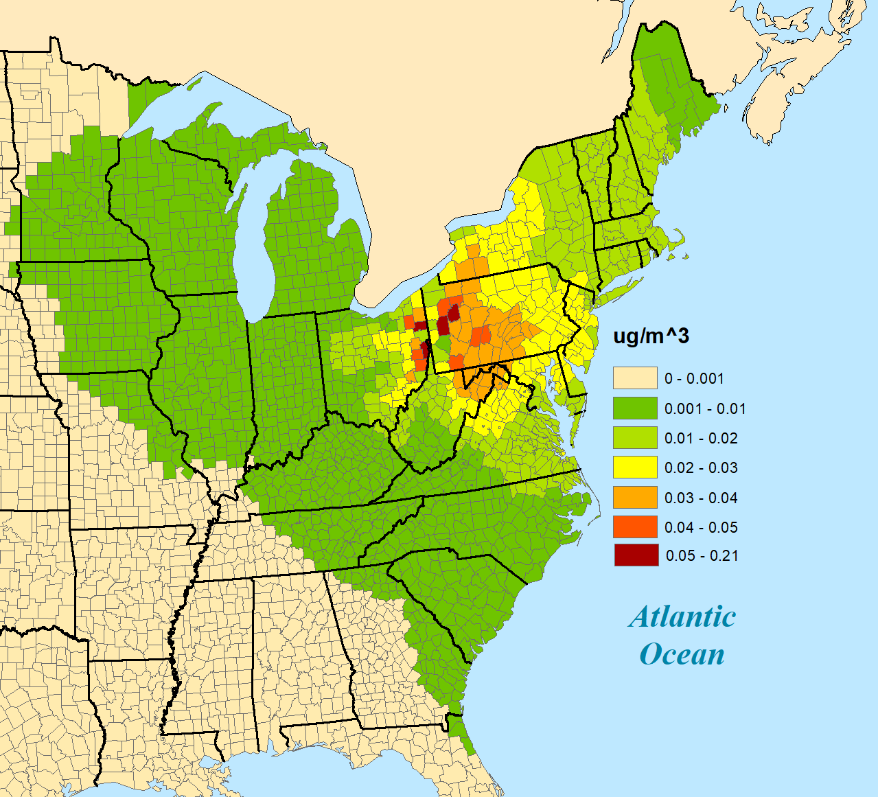
SO₂, NO_{x}, and PM_{2.5} Emissions (2014) from Bruce Mansfield

Slide 7
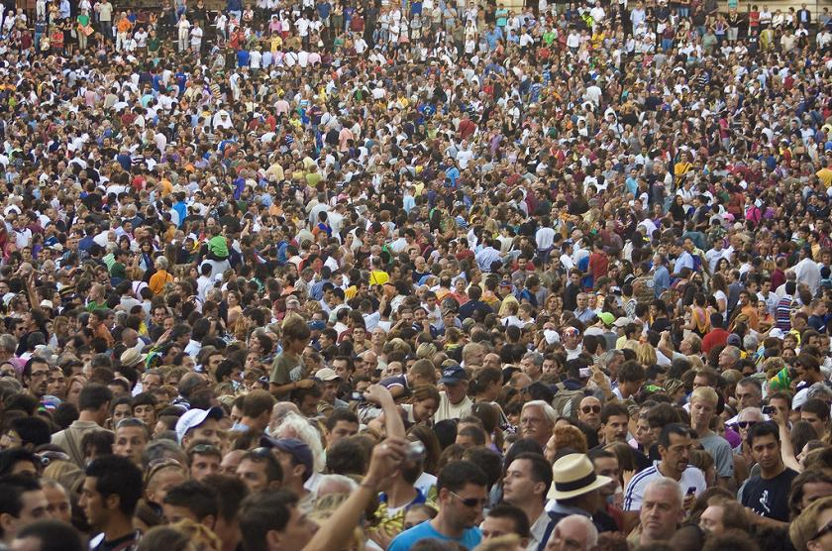
SO₂, NO_{x}, and PM_{2.5} Emissions (2014) from Bruce Mansfield

Slide 9
Key Distinctions from Climate Context.
Pollutants are not uniformly mixed.
Policy implications?
Pollutants are flow not stock.
Policy implications?
Some pollutants have highly non-linear behavior.
Policy implications?

Slide 10
Plan for Today
Structure of air pollution IAMs.
Data sources.
Model design.
Parameter choices.
Marginal damages.
Applications.
Efficient pollution control.
Environmental accounts.
Technology choice.

Slide 11
Market and Policy
Forces
Emissions
Valuation
Air Quality
Model
Integrated
Assessment
Models
Dose-Response
Ambient
Concentration
Exposure

Slide 12
Emissions
USEPA National Emission Inventories for (1999, 2002, 2005, 2008, 2011). Annual emissions from both individual sources and spatially aggregated sources.
PM_{2.5}, SO₂, NO_{x}, VOC, NH₃ (All emissions of 5 pollutants in the contiguous US.)
Source location, specifications (effective height), industry.
Some emissions are measured by USEPA.
Some emissions are modeled by USEPA.

Slide 13
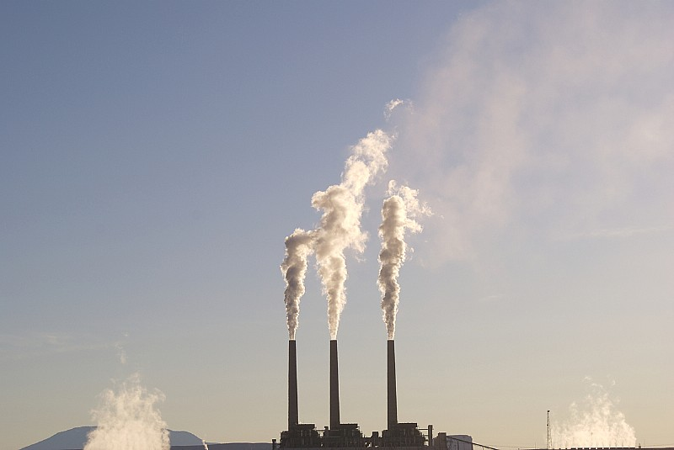
Emissions
USEPA Data
Measured emissions.
Timing

Slide 14
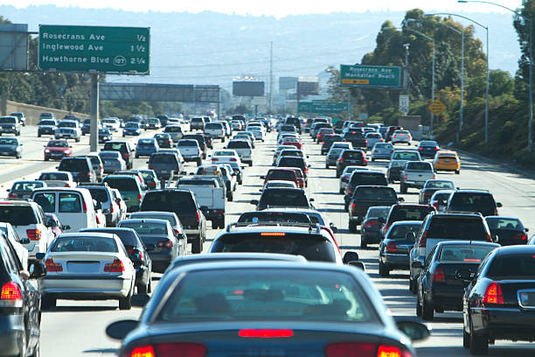
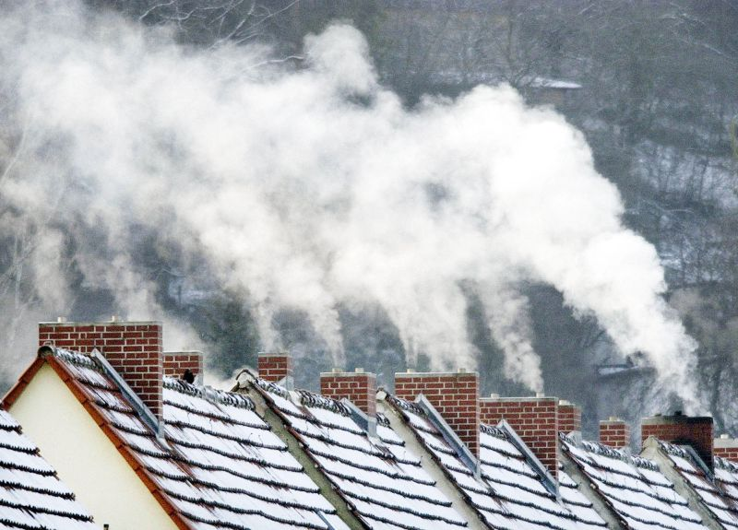
Emissions
USEPA Data
Modeled emissions.
Formulae.

Slide 15
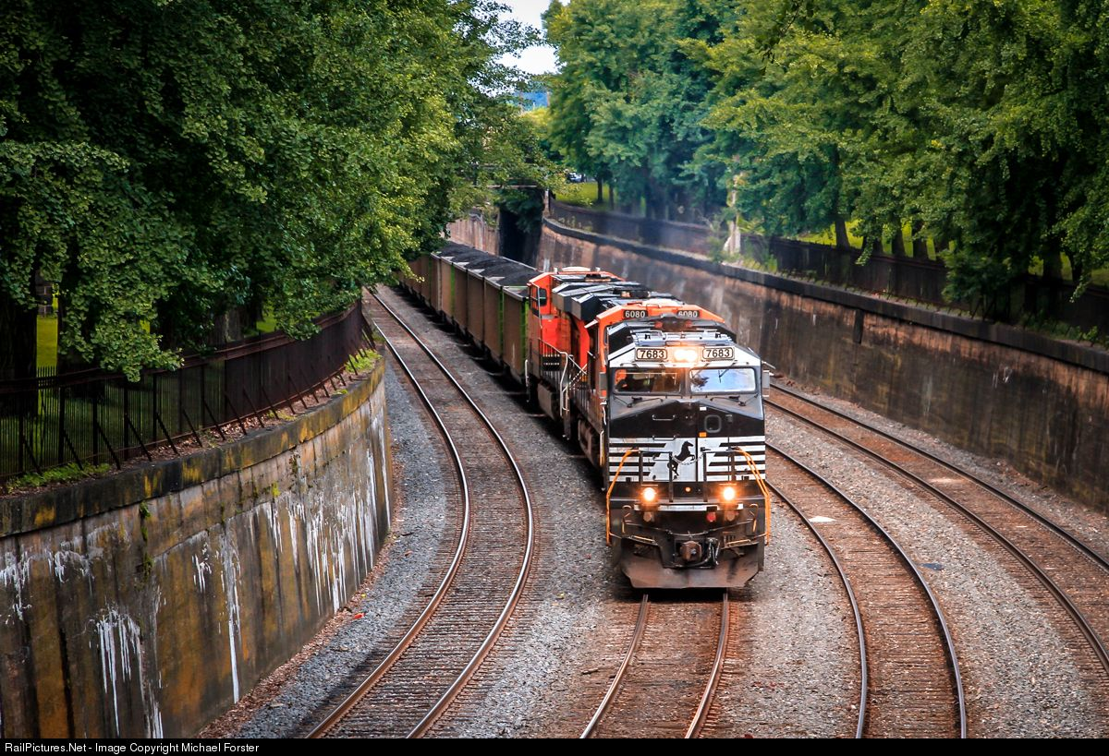
Emissions
USEPA Data
Modeled emissions.
Formulae.

Slide 16
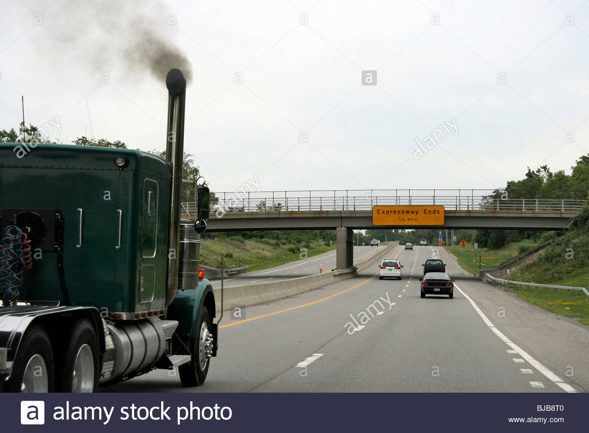
Emissions
USEPA Data
Modeled emissions.
Formulae.

Slide 17
Market and Policy
Forces
Emissions
Valuation
Air Quality
Model
Integrated
Assessment
Models
Dose-Response
Ambient
Concentration
Exposure

Slide 18
Air Quality Model
This is the margin on which most IAMs for air pollution differ.
At one end of the spectrum, chemical transport models (CTMs) provide comprehensive temporal, spatial, chemical resolution.
CMAQ, CAMx, PM-CAMx.
Extremely computationally intensive.
At the other end, reduced complexity models (RCMs).
APEEP-family, EASIUR, InMAP.
Economize on spatial, temporal, chemical details.

Slide 19
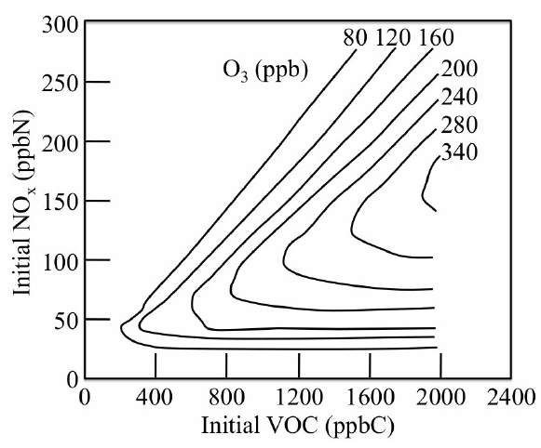
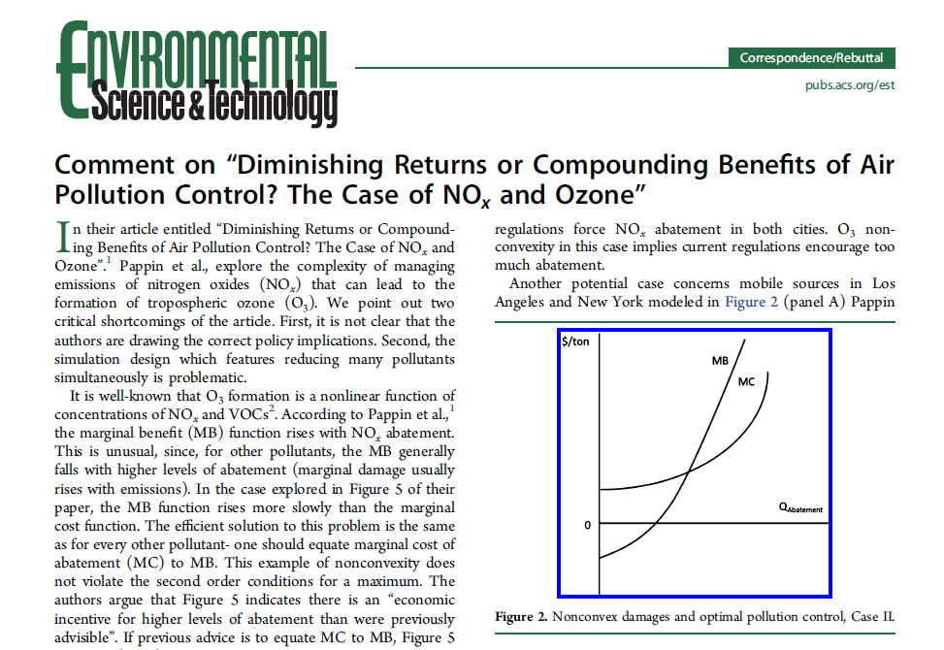
Air Quality Model: CTMs
CTMs operate on hourly (or smaller) time step.
Crucial advantage is settings involving non-linear chemistry.

Slide 20
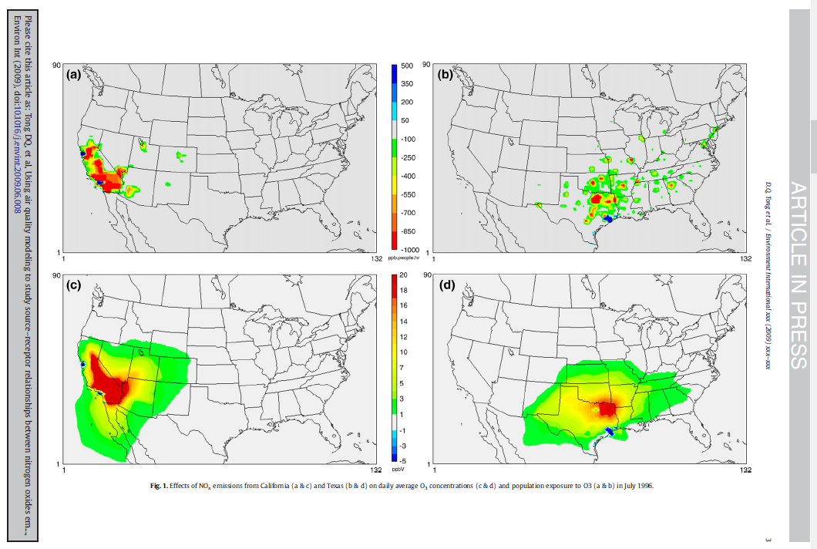
Air Quality Model: CTMs
Source: Tong, Muller, Mendelsohn, 2009

Slide 21
Air Quality Model: CTMs
Source: Tong, Muller, Mendelsohn, 2009

Slide 22
Air Quality Model: CTMs
CTMs operate on hourly (or smaller) time step.
Crucial advantage is settings involving non-linear chemistry.
Figure 1: Partial Effects of Total Nitrate and Free Ammonia on PNO₃ Formation

Slide 23
Air Quality Model: RCMs
Three models (CACES Center): AP3, EASIUR, InMAP.
RCMs often linearize, approximate complex processes.
AP3 uses Gaussian Plume Modeling.
EASIUR approximates CTMs with regression analysis.
InMAP CTM-Lite, no temporal detail.
Focus here on AP3.

Slide 24
Air Quality Model
Linear Algebraic approach.
Emission vectors (1 x s).
Source-receptor matrix (s x r).
(1 x s) x (s x r) = (1 x r) vector of PM_{2.5}.
Distinct vectors and matrices for:
Precursor emissions: NO_{x}, SO₂, VOC, NH₃, and PM_{2.5}.
Emission heights: ground level, generalized stack, ~700 tall stacks.

Slide 25
Air Quality Model
Limitations of reduced form approach.
Pollution episodes, atmospheric inversions.
Spatial resolution: heterogeneity within county receptors.
Atmospheric chemistry.
Advantages of source-receptor matrix approach.
Computational efficiency.
Model domain & resolution.

Slide 26
Air Quality Model: AP3
Each cell contains a transfer coefficient (T_{s,r}).
Conveys change in (ug/m³) annual average concentration (county r), due to one U.S. short ton of emissions (s).
(T_{s,r}) estimated based on Gaussian Plume (Turner, 1994).

Slide 27
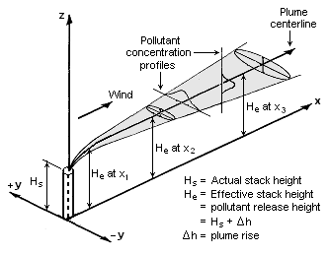
Air Quality Model

Slide 28
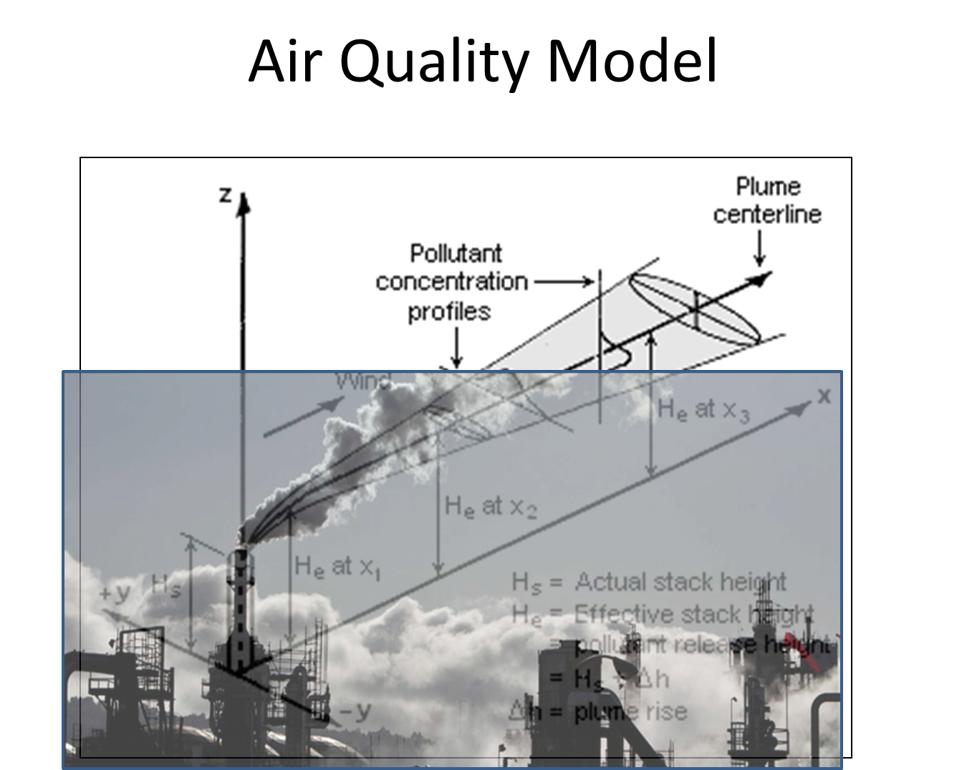

Slide 29
Air Quality Model: AP3
Enhancements to basic Gaussian Plume.
Modified to approximate atmospheric chemistry (reduced form approach).
SO₂, NO_{x}, NH₃, VOC form: total PM_{2.5}
SO₂, VOC rate constants.
NH₃ & NO_{x} interaction in regression-based approximation of CAMx.
Also depends on free NH₃, emissions and scavenging by SO₂.
Primary PM_{2.5}, no chemistry – straight dispersion.
Probability-weighted wind direction, speed, mixing height.

Slide 30
Air Quality Model: AP3
AP3 now estimated for 1999, 2002, 2005, 2008, 2011, and 2014.
2017 in 2020.
Why update?
Emissions change.
Why?
Do all emissions change proportionately to one another?
Regulation: Target SO₂ and NO_{x}, frees up NH₃.
Gas vs. coal?
Evaluate AP3 against CTM and AQS monitor data.

Slide 31
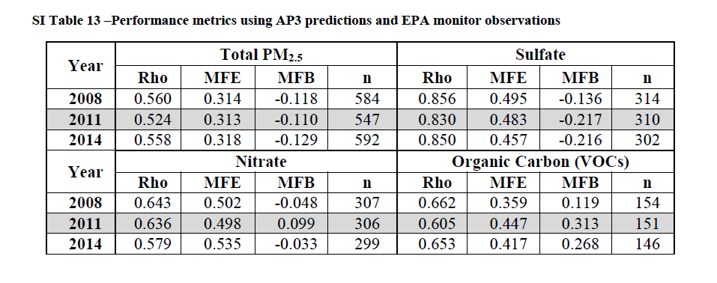
AP3 Error and Bias Test Statistics
Source: Sergi et al., 2019.

Slide 32
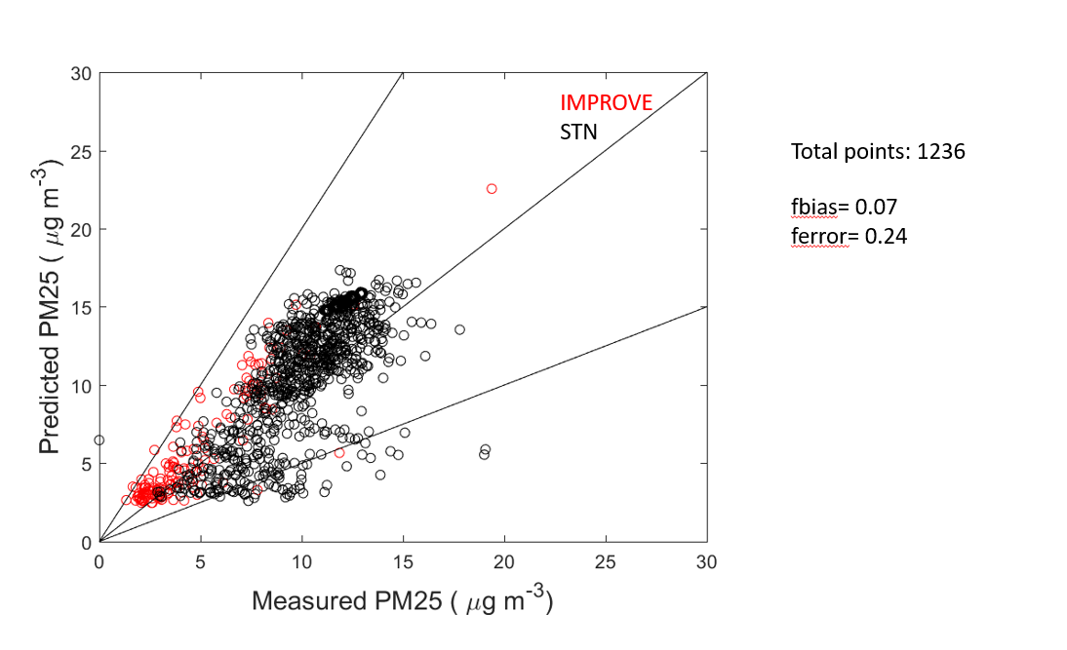
AP3 Error and Bias Test Statistics
Source: Sergi et al., 2019.
Source: Adams et al., 2019.

Slide 33
Market and Policy
Forces
Emissions
Valuation
Air Quality
Model
Integrated
Assessment
Models
Dose-Response
Ambient
Concentration
Exposure

Slide 34
AP3 PM_{2.5} Predictions

Slide 35
Market and Policy
Forces
Emissions
Valuation
Air Quality
Model
Integrated
Assessment
Models
Dose-Response
Ambient
Concentration
Exposure

Slide 36
Exposures
With county concentration estimates, next step is exploring who and what is exposed.
County population estimates: U.S. Census.
Subdivided into 19 age groups.
Mortality rates vary by age.
Can also model gender, race – not common.
County crop yields, timber yields. (USDA).
O₃ adversely effects agr., and timber production.
Man-made materials. (Muller, Mendelsohn, 2007).

Slide 37
Market and Policy
Forces
Emissions
Valuation
Air Quality
Model
Integrated
Assessment
Models
Dose-Response
Ambient
Concentration
Exposure

Slide 38
Dose-Response
AP3 uses peer-reviewed dose-response functions to translate concentration and exposure into physical effects.
Mortality.
PM_{2.5}: Krewski et al. (2009), Lepeule et al., (2012).
Models can use recent work from env. econ.
Morbidity.
Chronic vs. acute: caution with double counting.

Slide 39
Dose-Response
In the news…
USEPA charged with periodically updating “criteria” used to set air quality standards.
For NAAQS, this hinges on mortality.
For 40+ years, evidence of stable linear relationship at levels of PM_{2.5} and PM₁₀ observed in the U.S.
Trump USEPA claims no harm below 12 ug/m³.
No threshold found in literature.

Slide 40
Dose-Response:
Non-health endpoints.
Crops: soybeans, wheat, corn, peanuts, cotton, sorghum.
Lesser et al., 1990 (NCLAN).
Timber: detailed USFS inventory data.
Dose-response (Muller, Mendelsohn, 2007).
Materials.
NAPAP, ICP.

Slide 41
Market and Policy
Forces
Emissions
Valuation
Air Quality
Model
Integrated
Assessment
Models
Dose-Response
Ambient
Concentration
Exposure

Slide 42
Valuation of Mortality Risk
How economists think about individual choice.
How health risks fit into this structure.
Examples from the theoretical literature.
Valuation results from the empirical literature.
Quick demo for air pollution.
Challenges/uncertainties.

Slide 43
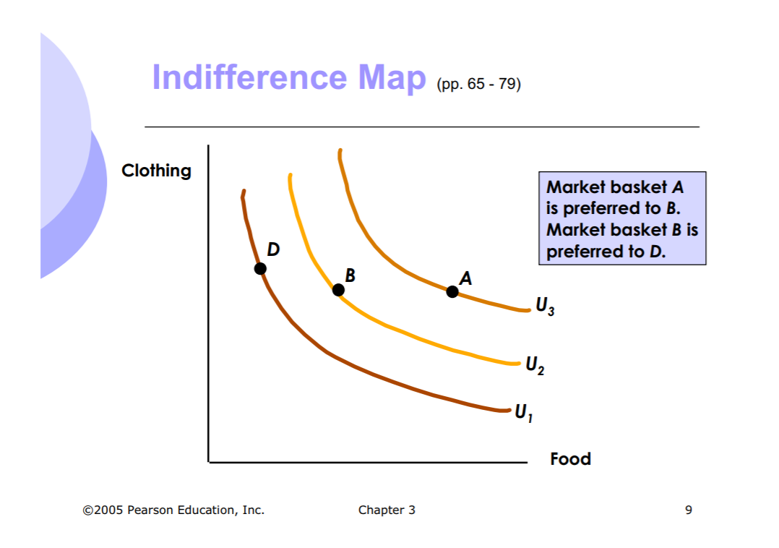
Indifference Curves

Slide 44
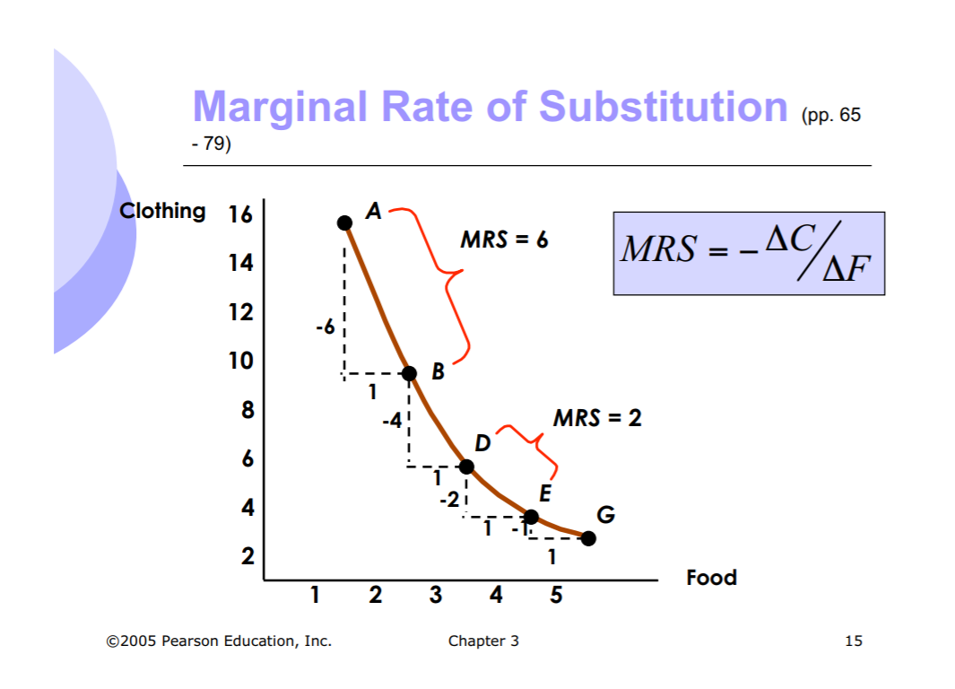
Indifference Curves
44

Slide 45
Indifference Curves
Previous graphs show canonical example of tradeoffs:
Food and clothing.
45

Slide 46
Indifference Curves
Previous graphs show canonical example of tradeoffs:
Food and clothing.
Both goods traded in markets.
46
46

Slide 47
Indifference Curves
Previous graphs show canonical example of tradeoffs:
Food and clothing.
Both goods traded in markets.
Well-defined prices.
47
47

Slide 48
Indifference Curves
Previous graphs show canonical example of tradeoffs:
Food and clothing.
Both goods traded in markets.
Well-defined prices.
Observable choices.
48
48

Slide 49
Indifference Curves
Previous graphs show canonical example of tradeoffs:
Food and clothing.
Both goods traded in markets.
Well-defined prices.
Observable choices.
Can we apply indifference curve analysis of choice to glean values for other phenomena…like risks?
49
49

Slide 50
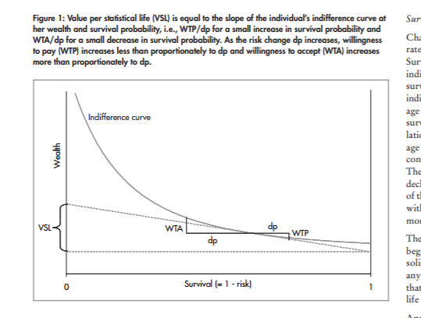
Utility Theoretic Analysis: Money & Mortality Risk
Source: Hammitt, 2008

Slide 51
Value of a Statistical Life (VSL)
The rate of tradeoff (MRS) between wealth and small changes in the risk of death in a given time period.
A person might be willing to pay $5 to reduce their chance of death by 1/(1 x 10⁶). This reveals a VSL of $5 million = $5/(1/1 x 10⁶).
Alternatively, a policy might induce risk reductions over 1 million people with willingness-to-pay of $5 per. On average, one death would be avoided and cumulative WTP = a VSL of $5 million.
The slope of an indifference curve b/w wealth and mortality risk.

Slide 52
Value of a Statistical Life (VSL)
The rate of tradeoff between wealth and small changes in the risk of death in a given time period, depends on the magnitude of the risk change.
Typical person WTP $5 to reduce chance of death by 1/(1 x 10⁶).

Slide 53
Value of a Statistical Life (VSL)
The rate of tradeoff between wealth and small changes in the risk of death in a given time period, depends on the magnitude of the risk change.
Typical person WTP $5 to reduce chance of death by 1/(1 x 10⁶).
Does not mean WTP $1 million to reduce chance of death by (1/5).
Does not mean accept certain death in exchange for $5 million.

Slide 54
Valuation: How?
Revealed preference: ascertain people’s values for a good or service not traded in markets from closely related market transaction.

Slide 55
Valuation: How?
Revealed preference: ascertain people’s values for a good or service not traded in markets from closely related market transaction.
Value of mortality risk from labor market transactions.
$$W_{i,t}=β_{0}+β_{1}C_{i,t}+β_{2}I_{j,t}+β_{3}M_{j,t}+ε_{i,t}$$

Slide 56
Valuation: How?
Revealed preference: ascertain people’s values for a good or service not traded in markets from closely related market transaction.
Value of mortality risk from labor market transactions.
$$W_{i,t}=β_{0}+β_{1}C_{i,t}+β_{2}I_{j,t}+β_{3}M_{j,t}+ε_{i,t}$$
56

Slide 57
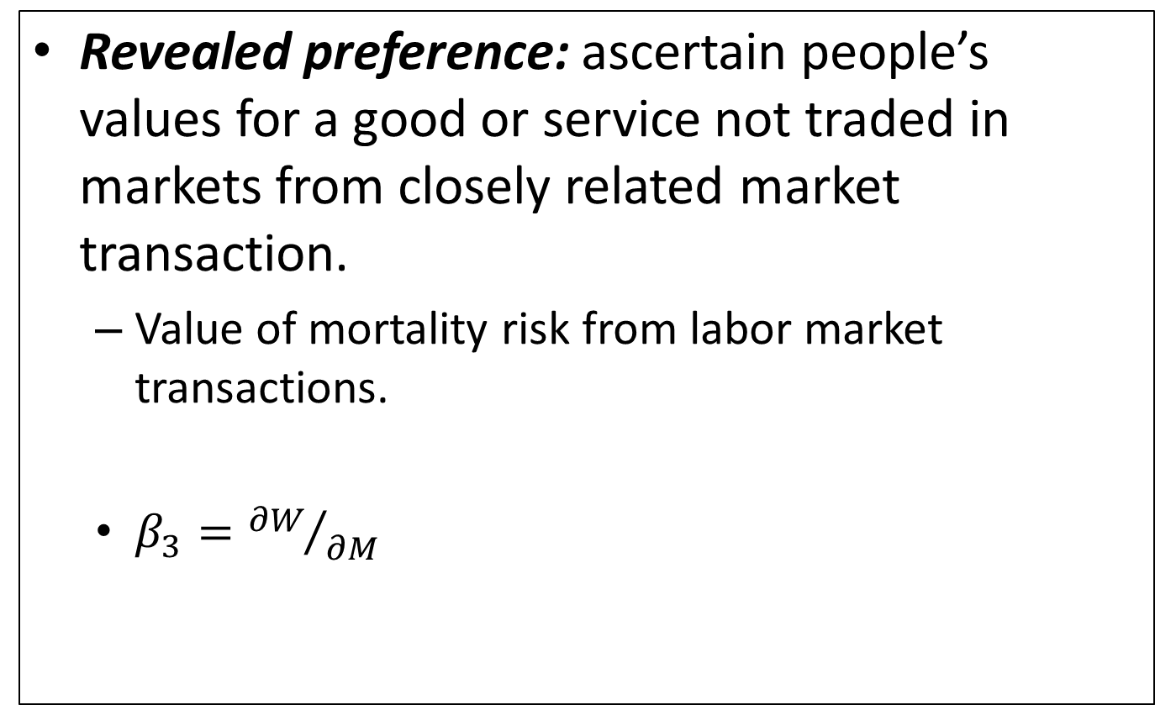
Valuation: How?
Revealed preference: ascertain people’s values for a good or service not traded in markets from closely related market transaction.
Value of mortality risk from labor market transactions.
$β_{3}={∂W}/{∂M}$
$$W_{i,t}=β_{0}+β_{1}C_{i,t}+β_{2}I_{j,t}+β_{3}M_{j,t}+ε_{i,t}$$
57
57

Slide 58
Valuation: How?
Revealed preference: ascertain people’s values for a good or service not traded in markets from closely related market transaction.
Value of mortality risk from labor market transactions.
Compensating wage differentials for “risky” or dangerous jobs.
Wage risk premium/risk increment = Value of a Statistical Life (VSL).

Slide 59
Valuation: How?
Stated preference: ascertain people’s values for a good or service not traded in markets by asking them about such values in highly structured survey.
Directly elicits willingness to pay (WTP) for mortality risk reductions.
Note that this is contingent.
Also yields estimate of VSL.

Slide 60
Valuation
USEPA’s VSL currently: $8.5 million ($2013).
Combination of revealed and stated preference studies through meta-analysis.
Viscusi and Aldy (2003), Mrozek and Taylor (2002), Kochi, Hubbell, Kramer (2006).
Derived from 26 studies published between 1974 and 1991:

Slide 61
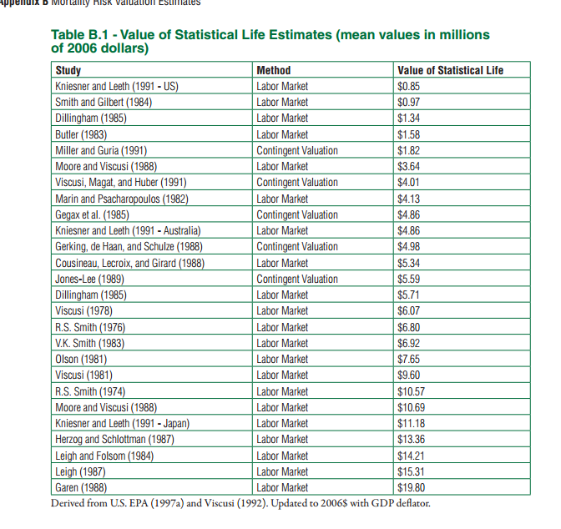
http://yosemite.epa.gov/ee/epa/eerm.nsf/vwAN/EE-0568-22.pdf/$file/EE-0568-22.pdf

Slide 62
Valuation
How does WTP to avoid mortality risk vary with observables?
Race.
Income.
Ethnicity.
Age.
USEPA’s current practice does not differentiate the VSL according to these population traits.
They did once: it didn’t go well.
There are, of course, ethical concerns associated with differentiation.
But there are ethical concerns associated with uniform VSL, too.

Slide 63
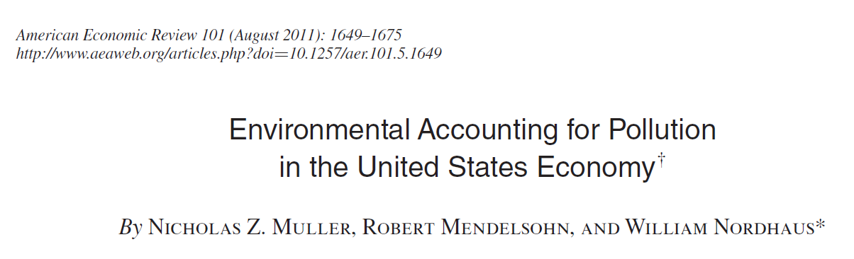
Valuation
How does allowing the VSL to vary over some population traits affect damage estimates?
Age:

Slide 64
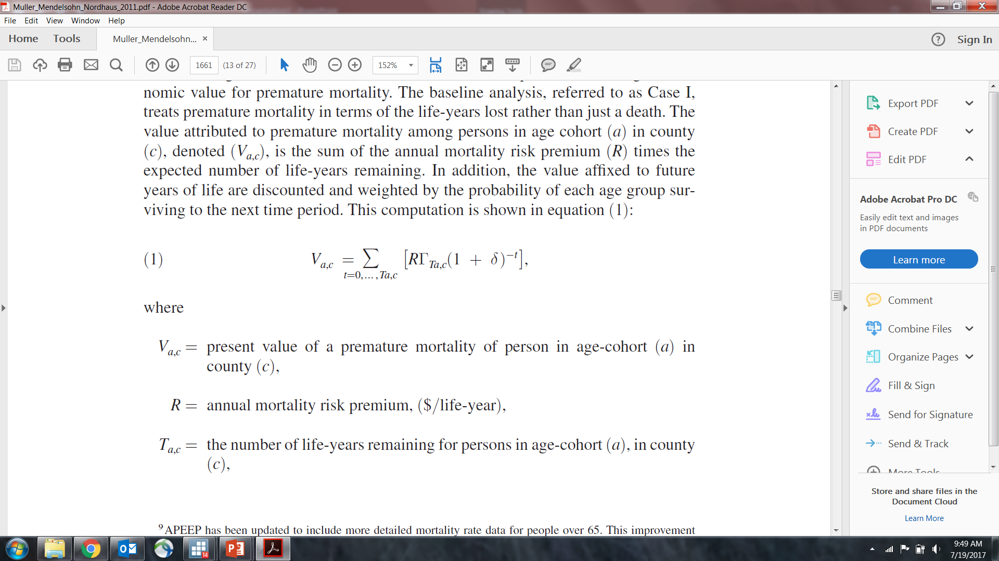
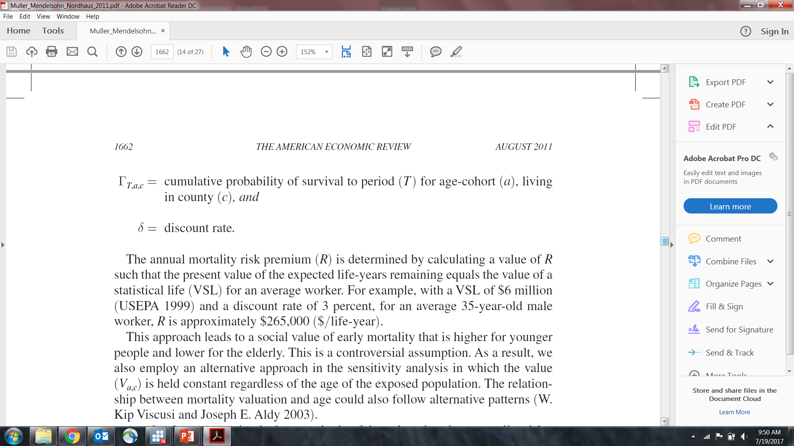
Valuation
How does allowing the VSL to vary over some population traits affect damage estimates?
Age:

Slide 65
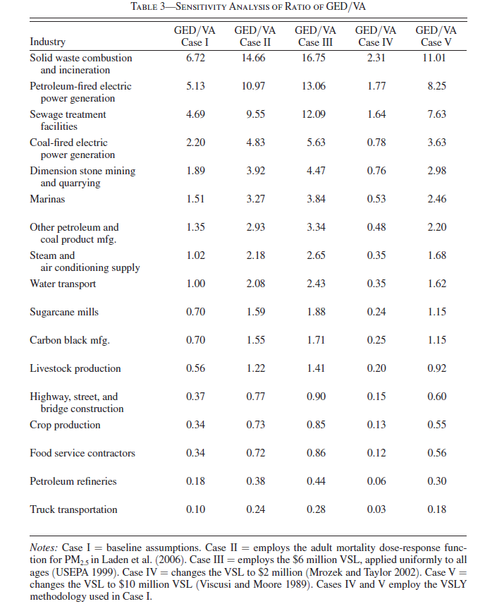
Valuation
How does allowing the VSL to vary over some population traits affect damage estimates?
Age:

Slide 66
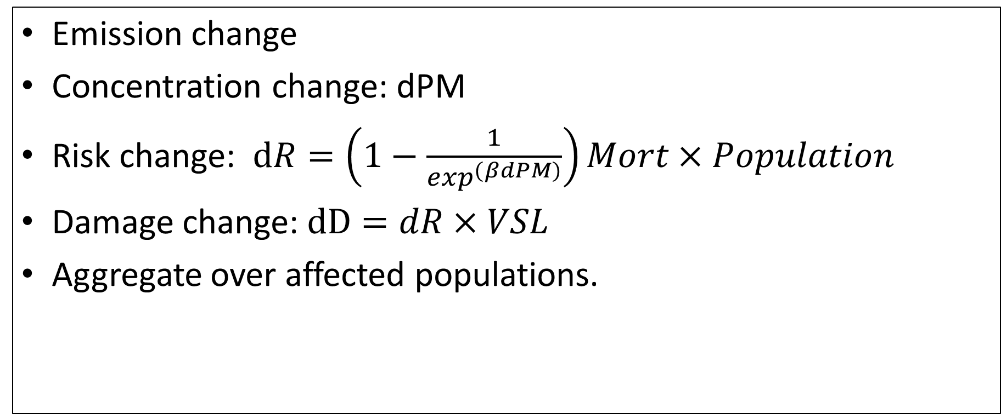
How to apply the IAMs?
Emission change
Concentration change: dPM
Risk change: $dR=\left(1−\frac{1}{\exp^{\left(βdPM\right)}}\right)Mort×Population$
Damage change: $dD=dR×VSL$
Aggregate over affected populations.

Slide 67
Emissions
Valuation
Air Quality
Model
Integrated Assessment
Model.
Ambient
Concentration
Dose-Response
Exposure

Slide 68
Policy
Intervention
Emissions
Valuation
Air Quality
Model
Integrated Assessment
Model.
Ambient
Concentration
Dose-Response
Exposure

Slide 69
Policy
Intervention
Direct
Costs
Emissions
Valuation
Air Quality
Model
Integrated Assessment
Model.
Ambient
Concentration
Dose-Response
Exposure

Slide 70
Policy
Intervention
Direct
Costs
Emissions
Valuation
Air Quality
Model
Integrated Assessment
Model.
Ambient
Concentration
Dose-Response
Exposure

Slide 71
Policy
Intervention
Direct
Costs
Emissions
Valuation
Air Quality
Model
Integrated Assessment
Model.
Ambient
Concentration
Dose-Response
Exposure

Slide 72
Policy
Intervention
Direct
Costs
Benefits
Emissions
Valuation
Air Quality
Model
Integrated Assessment
Model.
Ambient
Concentration
Dose-Response
Exposure

Slide 73
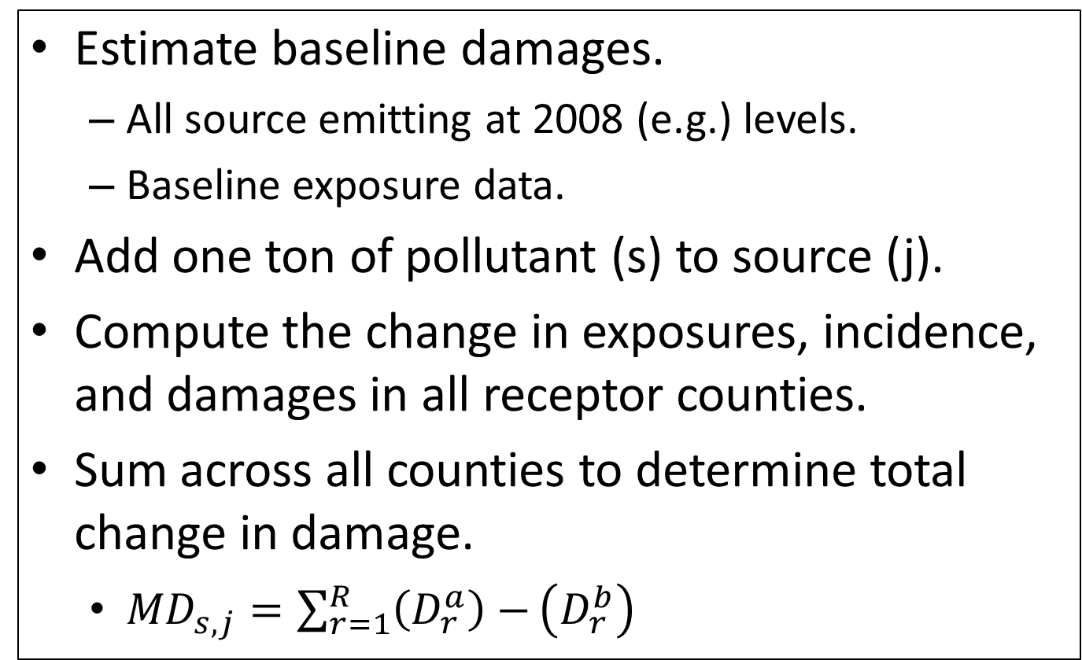
AP3 Marginal Damage Algorithm
Estimate baseline damages.
All source emitting at 2008 (e.g.) levels.
Baseline exposure data.
Add one ton of pollutant (s) to source (j).
Compute the change in exposures, incidence, and damages in all receptor counties.
Sum across all counties to determine total change in damage.
${MD}_{s,j}=\sum_{r=1}^{R}{\left(D_{r}^{a}\right)−}\left(D_{r}^{b}\right)$

Slide 74
AP3 Marginal Damage Algorithm
Estimate baseline damages.
All source emitting at 2008 (e.g.) levels.
Baseline exposure data.
Add one ton of pollutant (s) to source (j).
Compute the change in exposures, incidence, and damages in all receptor counties.
Sum across all counties to determine total change in damage.
${MD}_{s,j}=\sum_{r=1}^{R}{\left(D_{r}^{a}\right)−}\left(D_{r}^{b}\right)$
Repeat over 10,000 sources
and five pollutants.

Slide 75
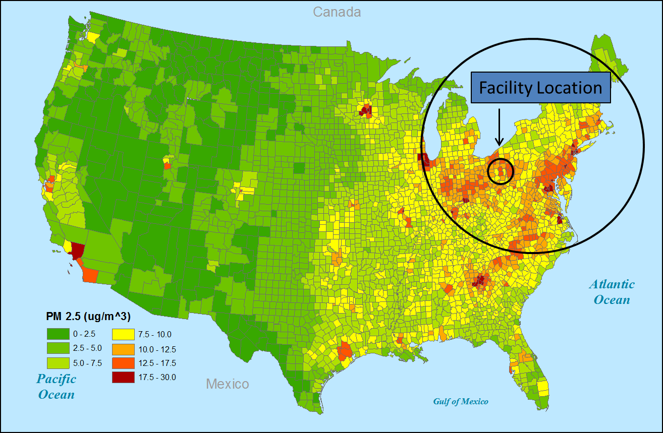
AP2 Marginal Damage Algorithm

Slide 76
100x Ton PM_{2.5} Emitted from RE Burger

Slide 77
One Ton PM_{2.5} Emitted from RE Burger
One Ton SO₂ Emitted from RE Burger

Slide 78
PM_{2.5} Damage/ton by County of Emission

Slide 79
SO₂ Damage/ton by County of Emission

Slide 80
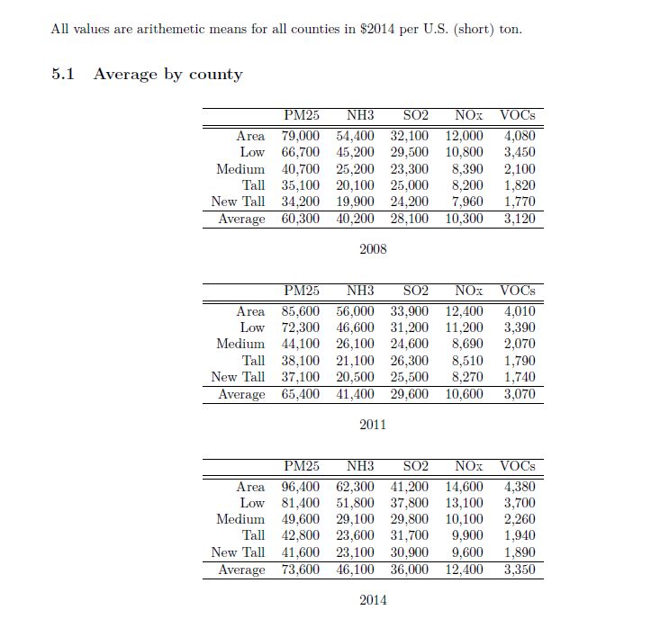
AP3 Marginal Damages
Source: Sergi et al., 2019

Slide 81
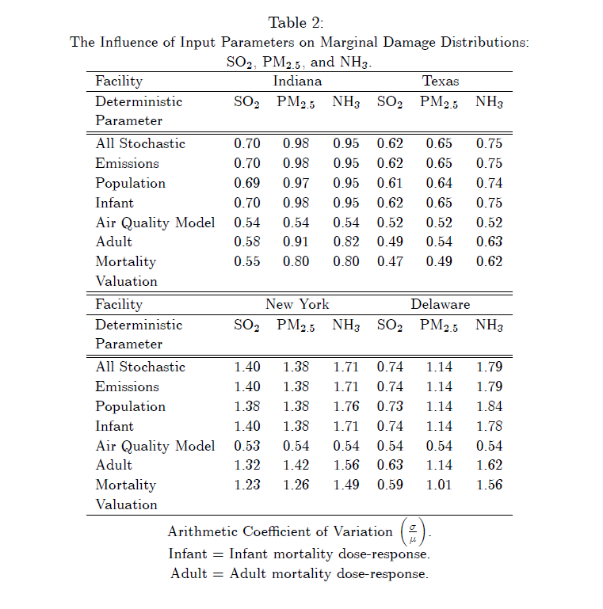
Lest we forget uncertainty…
Muller (2011) developed Monte Carlo Analysis in AP2.
Used distributional assumptions on input parameters from lit.
Picked a few sources, computed empirical MD distributions.
Multiplicative model: highly right-skewed.
Sensitive to AQM, Dose-Response, and VSL.

Slide 82
Common applications of IAMs.
Policy design/evaluation papers.
Rely on marginal damages.
Neoclassical position on allocatively efficient policy.
Environmental accounting papers.
Growth, damage shares of output, by sector.
Technology and Distributional Impacts.
EVs

Slide 83
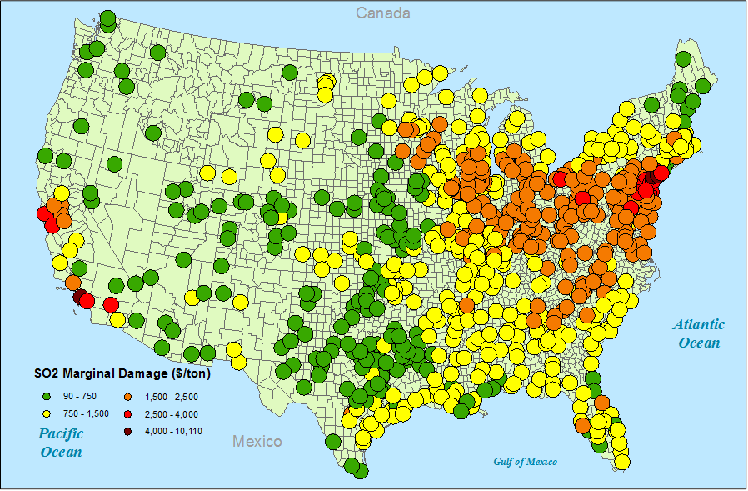
Muller and Mendelsohn, 2009 (AER)
Use elasticity of MAC for SO₂ from the literature.
Keohane (2006); Carlson et al., (2000).
Assumed current permit market (uniform price SO₂) operating cost-effectively.
Back out intercept for MAC, by plant, using reported emissions data.
Estimate MD for SO₂ for all plants in the ARP.

Slide 84
Muller and Mendelsohn, 2009 (AER)
Use elasticity of MAC for SO₂ from the literature.
Keohane (2006); Carlson et al., (2000).
Assumed current permit market (uniform price SO₂) operating cost-effectively.
Back out intercept for MAC, by plant, using reported emissions data.
Estimate MD for SO₂ for all plants in the ARP.
Found MD functions for all plants – nearly perfectly elastic.

Slide 85
Muller and Mendelsohn, 2009 (AER)
Use elasticity of MAC for SO₂ from the literature.
Keohane (2006); Carlson et al., (2000).
Assumed current permit market (uniform price SO₂) operating cost-effectively.
Back out intercept for MAC, by plant, using reported emissions data.
Found MD functions were perfectly elastic.
Identified optimal emissions level across all regulated plants.
Added it up: net welfare gain of b/w $300M and $950M. Source?
Exceeded estimates of cost-savings from SO₂ C&T program.

Slide 86
Common applications of IAMs.
Policy design/evaluation papers.
Rely on marginal damages.
Neoclassical position on allocatively efficient policy.
Environmental accounting papers.
Growth, damage shares of output, by sector.
Technology and Distributional Impacts.
EVs

Slide 87
Muller, 2014 (Science)
Computed marginal damage using AP2.
All reported sources, 5 local pollutants.
Coupled with emissions data to estimate GED.
How is GDP computed?
Why this approach?
Shortcomings?
How to estimate GED?
GED_{s,i,c,t} = MD_{s,i,c,t} x E_{s,i,c,t}
Deflate and then compute real growth.
Compare to real growth in GDP.

Slide 88
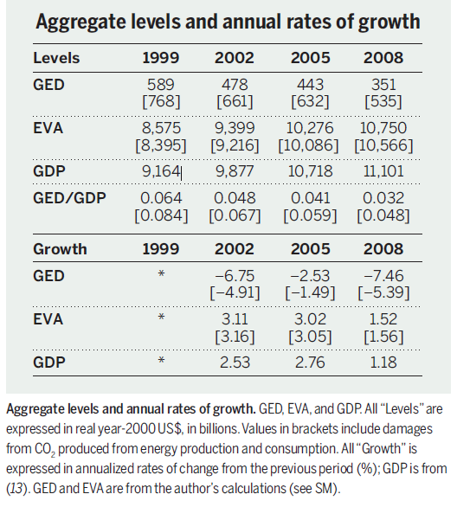
GDP, GED, and EVA.
Source: Muller, 2014

Slide 89
GDP, GED, and EVA.
Source: Muller, 2014

Slide 90
GDP, GED, and EVA.
Source: Muller, 2014

Slide 91
GDP, GED, and EVA.
Source: Muller, 2014

Slide 92
GDP, GED, and EVA.
Source: Muller, 2014

Slide 93
GDP, GED, and EVA.
Source: Muller, 2014

Slide 94
GDP, GED, and EVA.
Source: Muller, 2015
2011
268 [423]
11,548 [11,393]
11,816
0.023 [0.036]
2011
-7.53 [-5.50]
2.42 [2.54]
2.10
Source: Muller, 2014

Slide 95
Pollution Damage Intensity:1999.
Source: Muller, 2014.

Slide 96
Pollution Damage Intensity:2008.
2008
Source: Muller, 2014.

Slide 97
Utility VA, GED, and EVA:1999 to 2011.
Source: Author’s calculations and USBEA.

Slide 98
Utility and Mfg. Growth:1999 to 2011.
Sector | Performance Measure | 1999-2002 | 2002-2005 | 2005-2008 | 2008-2011 | 1999-2011
Utility | EVA | 9.24^{A} | 16.19 | 23.01 | 12.57 | 15.17
 | VA | -2.38 | 0.87 | 2.83 | 0.79 | 0.51
Mfg. | EVA | 2.10 | 5.12 | 1.14 | 3.71 | 3.01
 | VA | 1.31 | 4.19 | 0.50 | 3.45 | 2.53
A = All values are annualized real rates of change
over 3-year, and 12-year periods in percentage points.
Source: Author’s calculations and USBEA.

Slide 99
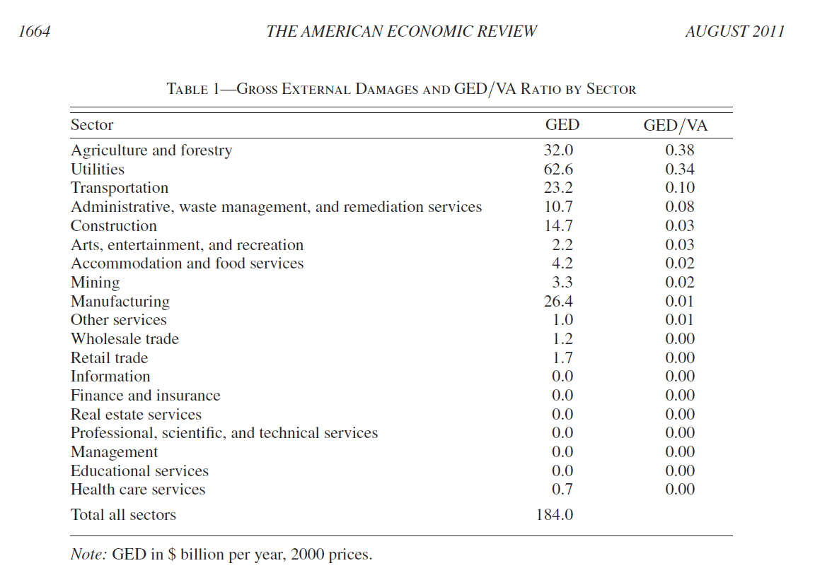
Detailed Results for 2002
Source: Muller et al., 2011

Slide 100
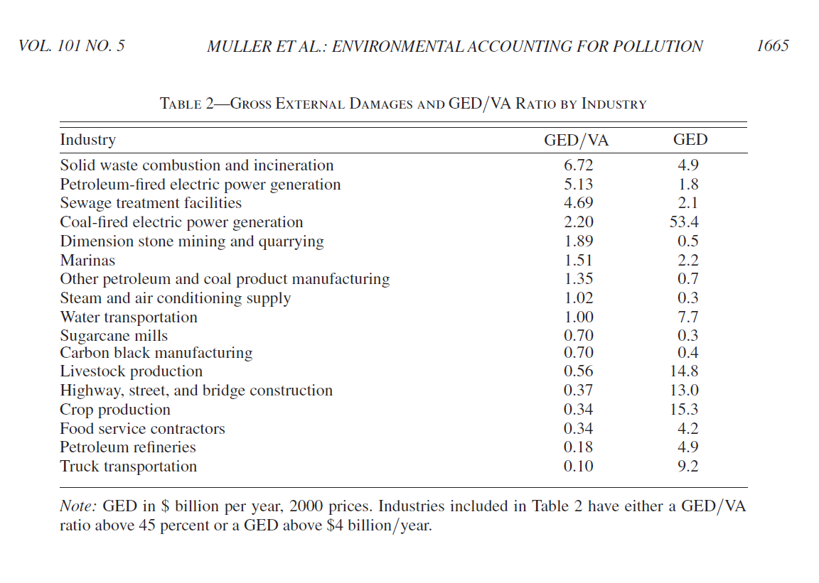
Detailed Results for 2002
Source: Muller et al., 2011

Slide 101
Common applications of IAMs.
Policy design/evaluation papers.
Rely on marginal damages.
Neoclassical position on allocatively efficient policy.
Environmental accounting papers.
Growth, damage shares of output, by sector.
Technology and Distributional Impacts.
EVs

Slide 102
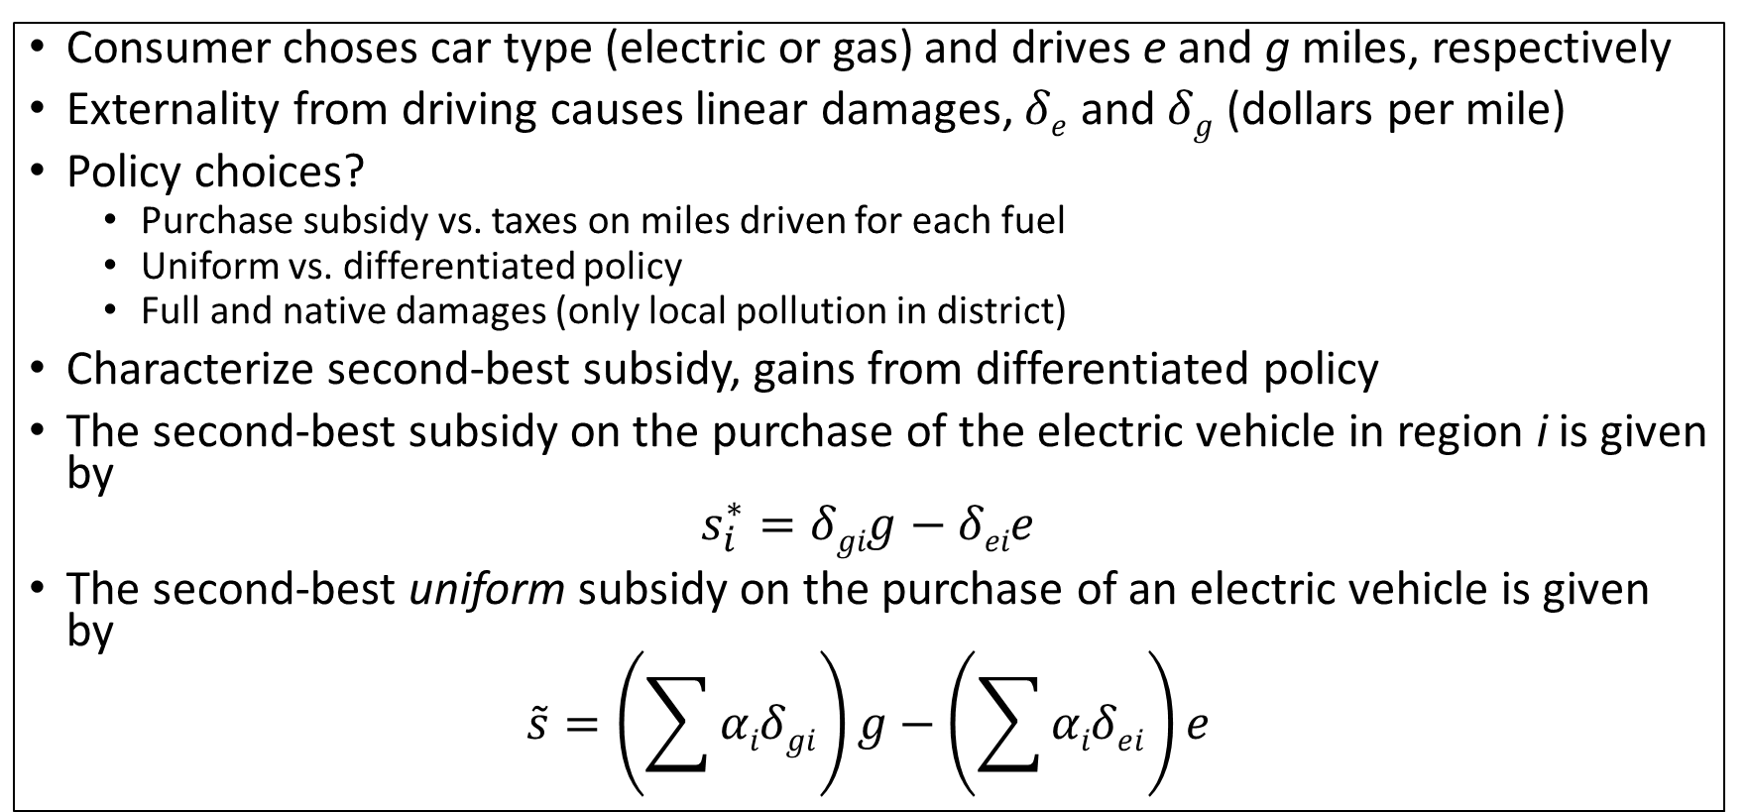
Holland, Mansur, Muller, Yates (2016) AER
Consumer choses car type (electric or gas) and drives e and g miles, respectively
Externality from driving causes linear damages, $δe$ and $δg$ (dollars per mile)
Policy choices?
Purchase subsidy vs. taxes on miles driven for each fuel
Uniform vs. differentiated policy
Full and native damages (only local pollution in district)
Characterize second-best subsidy, gains from differentiated policy
The second-best subsidy on the purchase of the electric vehicle in region i is given by
$$s_{i}^{∗}=δgig−δeie$$
The second-best uniform subsidy on the purchase of an electric vehicle is given by
$$\tilde{s}=\left(\sum{αiδgi}\right)g−\left(\sum{αiδei}\right)e$$

Slide 103
Air pollution damages modeling
Map emissions from tailpipe or smokestack emissions to changes in air quality to changes in human health and environmental quality to economic valuation
AP2 model (Muller 2014)
Emissions & damage of CO₂, PM_{2.5}, SO₂, NO_{x}, and VOC.
Both full and native damages using valuation estimates from the literature
Counties are spatial unit
Vehicle information from EPA (GREET) on emissions rates of ICE and MPGe for EVs, adjusting for urban/rural and temperature

Slide 104
PM2.5 from gas car in Atlanta

Slide 105
PM2.5 from electric car in Atlanta

Slide 106
Spatial heterogeneity of environmental benefits of EVs
Gasoline-powered 2014 Ford Focus
Electric 2014 Ford Focus

Slide 107
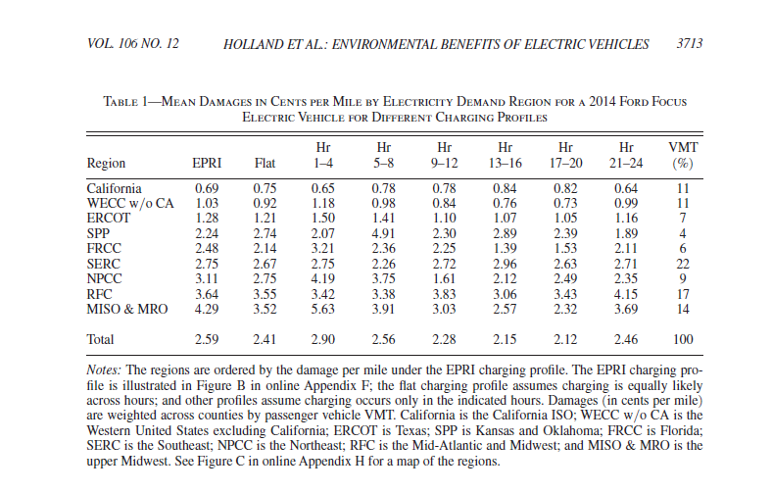

Slide 108
Environmental benefit of an EV
Electric v. Gasoline 2014 Ford Focus (each driven 150k miles)

Slide 109


Slide 110


Slide 111


Slide 112
Electric vehicle subsidy: Full v. native
Full Damages
Native Damages
Electric v. Gasoline 2014 Ford Focus

Slide 113
Plan for Today
Structure of air pollution IAMs.
Data sources: varying accuracy/coverage.
Model design: CTMs vs RCMs.
Parameter choices: VSL & Dose-response.
Marginal damages: brute force, changing over time.
Applications.
Efficient pollution control.
Environmental accounts.
Technology choice.

Slide 114
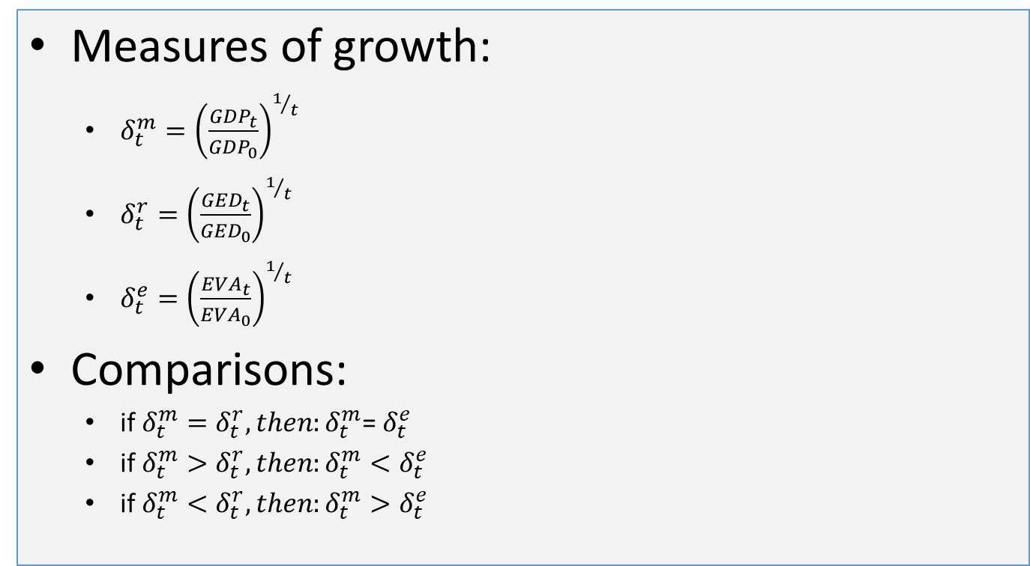
Conceptual Modeling.
Measures of growth:
$δ_{t}^{m}={\left(\frac{{GDP}_{t}}{{GDP}_{0}}\right)}^{1/t}$
$δ_{t}^{r}={\left(\frac{{GED}_{t}}{{GED}_{0}}\right)}^{1/t}$
$δ_{t}^{e}={\left(\frac{{EVA}_{t}}{{EVA}_{0}}\right)}^{1/t}$
Comparisons:
if $δ_{t}^{m}=δ_{t}^{r},then:δ_{t}^{m}$= $δ_{t}^{e}$
if $δ_{t}^{m}>δ_{t}^{r},then:δ_{t}^{m}<δ_{t}^{e}$
if $δ_{t}^{m}<δ_{t}^{r},then:δ_{t}^{m}>δ_{t}^{e}$

Slide 115
Conceptual Modeling.
Measures of growth:
$δ_{t}^{m}={\left(\frac{{GDP}_{t}}{{GDP}_{0}}\right)}^{1/t}$
$δ_{t}^{r}={\left(\frac{{GED}_{t}}{{GED}_{0}}\right)}^{1/t}$
$δ_{t}^{e}={\left(\frac{{EVA}_{t}}{{EVA}_{0}}\right)}^{1/t}$
Comparisons:
if $δ_{t}^{m}=δ_{t}^{r},then:δ_{t}^{m}$= $δ_{t}^{e}$
if $δ_{t}^{m}>δ_{t}^{r},then:δ_{t}^{m}<δ_{t}^{e}$
if $δ_{t}^{m}<δ_{t}^{r},then:δ_{t}^{m}>δ_{t}^{e}$

Slide 116
Conceptual Modeling.
Measures of growth:
$δ_{t}^{m}={\left(\frac{{GDP}_{t}}{{GDP}_{0}}\right)}^{1/t}$
$δ_{t}^{r}={\left(\frac{{GED}_{t}}{{GED}_{0}}\right)}^{1/t}$
$δ_{t}^{e}={\left(\frac{{EVA}_{t}}{{EVA}_{0}}\right)}^{1/t}$
Comparisons:
if $δ_{t}^{m}=δ_{t}^{r},then:δ_{t}^{m}$= $δ_{t}^{e}$
if $δ_{t}^{m}>δ_{t}^{r},then:δ_{t}^{m}<δ_{t}^{e}$
if $δ_{t}^{m}<δ_{t}^{r},then:δ_{t}^{m}>δ_{t}^{e}$

Slide 117
Conceptual Modeling.
Measures of growth:
$δ_{t}^{m}={\left(\frac{{GDP}_{t}}{{GDP}_{0}}\right)}^{1/t}$
$δ_{t}^{r}={\left(\frac{{GED}_{t}}{{GED}_{0}}\right)}^{1/t}$
$δ_{t}^{e}={\left(\frac{{EVA}_{t}}{{EVA}_{0}}\right)}^{1/t}$
Comparisons:
if $δ_{t}^{m}=δ_{t}^{r},then:δ_{t}^{m}$= $δ_{t}^{e}$
if $δ_{t}^{m}>δ_{t}^{r},then:δ_{t}^{m}<δ_{t}^{e}$
if $δ_{t}^{m}<δ_{t}^{r},then:δ_{t}^{m}>δ_{t}^{e}$

Slide 118


Slide 119
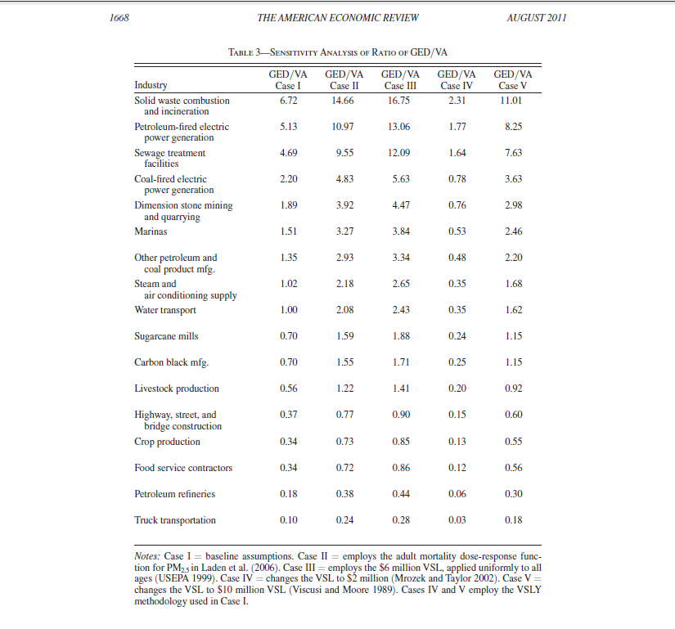
Source: Muller et al., 2011

Slide 120
Source: Muller et al., 2011

Slide 121
Source: Muller et al., 2011

Slide 122
Source: Muller et al., 2011

Slide 123
Source: Muller et al., 2011

Slide 124
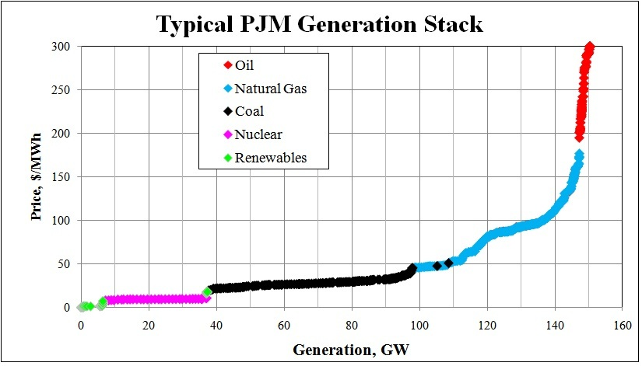
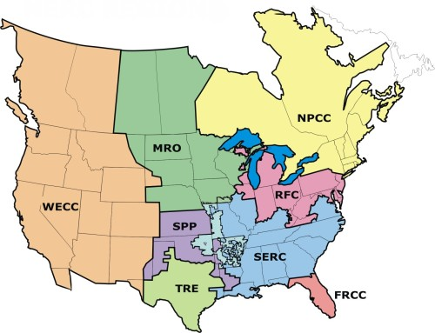
Electricity generation and air pollution
Economics of wholesale electricity
Electricity is not easy to store
Demand varies substantially
Markets are integrated/coordination key to avoid blackouts
Issues of startup costs; ramping constraints; transmission congestion; market power; imperfect information
Model the US electricity grid
NERC regions (9) are the spatial unit for electricity load shocks due to charging
Load shock in one region may affect entire grid
Electricity regressions estimate effects of change in load in NERC region on emissions of plants
Time of day when charged matters
D₃
D₁
D₂

Slide 125
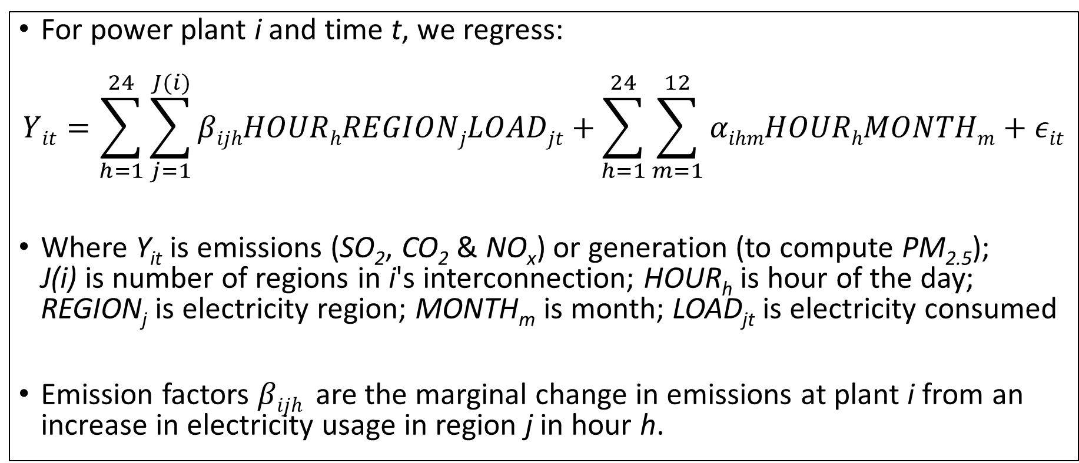
Electricity generation and air pollution
For power plant i and time t, we regress:
$$Yit=\sum_{h=1}^{24}{\sum_{j=1}^{J(i)}{βijhHOURhREGIONjLOADjt+}\sum_{h=1}^{24}{\sum_{m=1}^{12}{αihmHOURhMONTHm+εit}}}$$
Where Y_{it} is emissions (SO₂, CO₂ & NO_{x}) or generation (to compute PM_{2.5}); J(i) is number of regions in i's interconnection; HOUR_{h} is hour of the day; REGION_{j} is electricity region; MONTH_{m} is month; LOAD_{jt} is electricity consumed
Emission factors $βijh$ are the marginal change in emissions at plant i from an increase in electricity usage in region j in hour h.

